Slide 1
SUPERVISED LEARNING
KNN MODELS

Slide 2
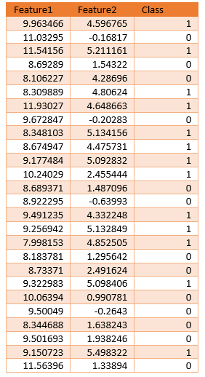
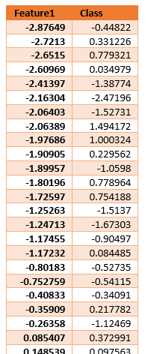
Consider the following sythentic datasets.
Can you identify which one is a classification and which one is a regression problem?
BUILDING SUPERVISED ML ALGORITHMS

Slide 3

Identify the problem - From the class label we can tell that the first is a classification problem while the second is a regression problem.
Inspect the data – To determine:
If we can solve the problem without machine learning,
If the desired information can be derived from the data
If your data has abnormalities that might mislead the algorithm
To simplify the tasks we shall use utility functions in mglearn to randomly generate datasets, load datasets, and visualize
•
Often a scatter plot is a good place to start visualizing your data when trying to answer the above questions.
Unfortunately, this is only possible for datasets with few features e.g. only two dimensions. If you have a large number of features, other plots such as pair plots may work better however they do not show the interaction of all of features at once.
BEFORE YOU START

Slide 4
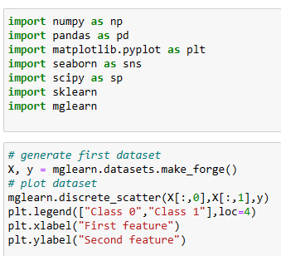
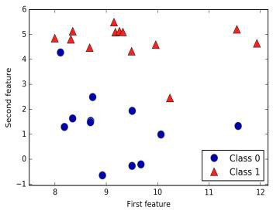
When visualize we immediately spot patterns in the data:
a low value for feature 2 means the class is 0 while a higher value means that the class is 1.
Feature 1 doesn’t appear to have any influence.
These are the rules that we hope the ML algorithms will detect and use to create the model.
Real life datasets have more features and therefore its difficult to visualize them and immediately detect patterns. We simply trust the algorithm in that case.
CLASSIFICATION

Slide 5
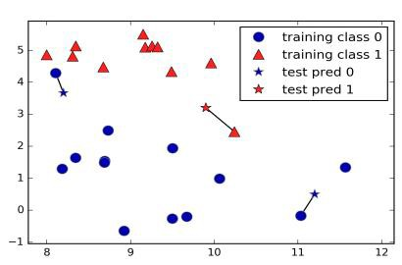
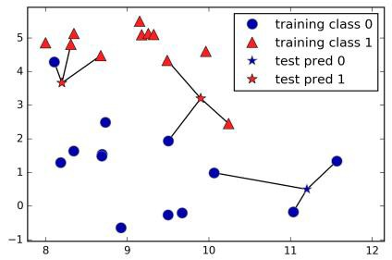
The k-NN algorithm is the simplest machine learning algorithm.
It identifies the nearest training data point to the one we are trying to predict and give it the same class.
In the diagram the data points we are trying to predict are
shown as stars and the closest training data point is shown.
An improvement of this algorithm can consider an arbitrary number of k training point’s neighbors.This is where the name of the k-nearest neighbor’s algorithm comes from. In this case we count how many neighbors belong to a class and assign the class with the majority (voting). In the diagram shown we use the three closest neighbors.The predication is the color assigned to the star. Picking an odd number ensures no ties.
Steps for Classification with kNN
The following are the major steps of the algorithm.
As in the general problem of classification, we have a set of data points for which we know the correct class labels.
When we get a new data point, we compare it to each of our existing data points and find similarity.
Take the most similar k data points (k nearest neighbors).
From these k data points, take the majority vote of their labels. The winning label is the label/class of the new data point.
K-NEAREST NEIGHBORS (KNN) CLASSIFIER

Slide 6
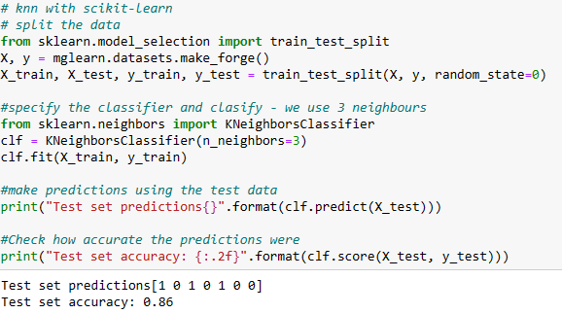
We use scikitlearn to shuffle, split the data and select the classifier. scikit-learn contains a function that shuffles the dataset and splits it for you (train_test_split function).
The train_test_split function shuffles the dataset using a pseudorandom number generator to ensure that the data in the test and train set have representative data
The train_test_split function process extracts 75% of the rows in the data as the training set, together with the corresponding labels for this data.The remaining 25% forms the test set. This ratio is a good rule of thumb but you can modify it as we shall see later.
In scikit-learn, data is usually denoted with a capital X, while labels are denoted by a lowercase y. This is inspired by the standard formulation f(x)=y in mathematics, where x is the input to a function and y is the output. Following more conventions from mathematics, we use a capital X because the data is a two-dimensional array (a matrix) and a lowercase y because the target is a one-dimensional array (a vector).
To make sure that we will get the same output if we run the same function several times, we provide the pseudorandom number generator with a fixed seed using the random_state parameter.This will make the outcome deterministic, so that we all have the same outcome.
Its not enough to build a ML model, you need to know whether it works well. To assess the model’s performance, we use the test data, (also called test set, or hold-out set). The 86% accuracy means that the model predicted the class correctly in the test data for 86% occurences.
IMPLEMENTING KNN CLASSIFIER

Slide 7
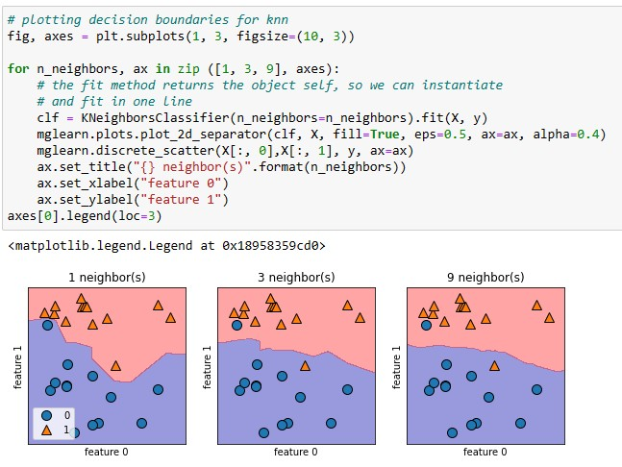
We can control KNN by varying the number of neighbors and analyzing the effect.
For two-dimensional datasets, we can visualize the prediction for all possible test points in the xy-plane.This lets us view the decision boundary, a line separating the classes.
This helps you make a decision on the ideal k value. From the diagram, a single neighbor results in a decision boundary that follows the training data closely while more neighbors leads to a smoother decision boundary.
A smoother decision boundary (many neighbors) corresponds to a simpler model which is susceptible to underfitting. This is because Many neighbors mean that each data point you want to predict will have exactly the same neighbors (all training points) and all predictions would be the same (the bigger class in the training set) hence low accuracy levels.
While few neighbors corresponds to high model complexity hence overfitting with high accuracy on training data but poor generalizability.
ANALYZING KNN CLASSIFIER RESULTS

Slide 8
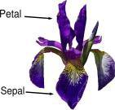
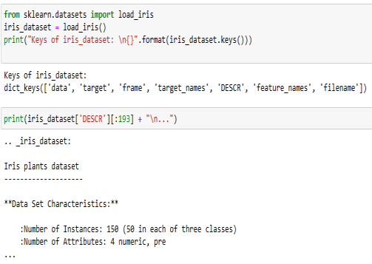
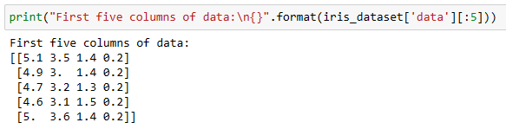
Let us apply this to real world datasets. scikit-learn comes with some real world examples which we can use but first we need to understand how they work
We begin with the iris dataset which is used to distinguishing the species of some iris flowers. It has measurements associated with each iris flower: the length and width of the petals and the length and width of the sepals, all measured in centimeters alongside the species (setosa, versicolor, or virginica). The goal is to find out if we can determine the specie from the sepal and petal measurements
Our goal is to build a machine learning model that can learn from the measurements of these irises whose species is known, so that we can predict the species for a new iris.
Because we have measurements for which we know the correct species of iris (Examples), this is a supervised learning problem.This is an example of a classification problem because in the class we have three categories.
Datasets that are included in scikit-learn are usually stored as Bunch objects, which contain some information about the dataset, the actual data, and some inbuilt functions that can help you manipulate the data. For example the data can be loaded using the load_iris function from scikit-learn.
They are stored as dictionaries with keys and values.You can display the keys or the values of each keys
Can you display the other keys and describe what they contain
USING INBUILT DATASET

Slide 9
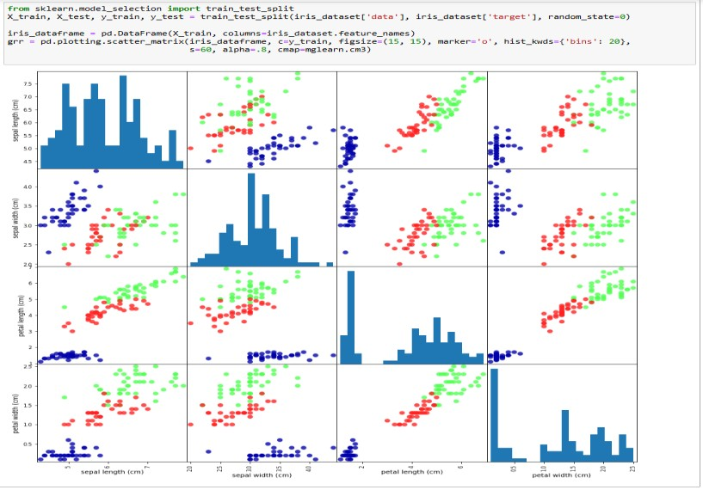
Because the data has several dimensions we use a pair plot of the features in the training set to visualize it. To create the plot, we first convert the NumPy array into a pandas DataFrame. Pandas has a function to create pair plots called scatter_matrix. The diagonal of this matrix is filled with histograms of each feature.
From the plots, we can see that the three classes seem to be relatively well separated using the sepal and petal measurements. This means that a machine learning model will likely be able to learn to separate them
VISUALIZING LARGER DATASET

Slide 10
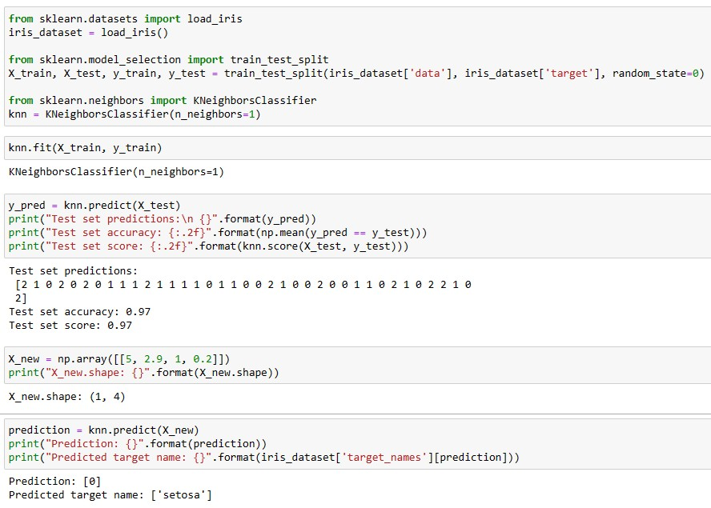
To build the model on the training set, we:
Split the data – shuffles and splits
Select the model - The algorithm object stores the algorithm and any information that the algorithm has extracted from the training data.
Fit with training data
To evaluate the model we calculate the accuracy or call score. Accuracy is by calculating as the fraction of flowers for which the right species was predicted.We can also use the score method of the knn object, which will compute the test set accuracy
To Making Predictions – Supply the model with a data point e.g. we found an iris with a sepal length of 5 cm, a sepal width of 2.9 cm, a petal length of 1 cm, and a petal width of 0.2 cm.What species of iris would this be? Put the new data in Numpy array and call method predict for this data (the same way we did with the test data). The prediction returns the numeric representation and you can retrieve the actual name from the target name property.
MAKING PREDICTIONS

Slide 11
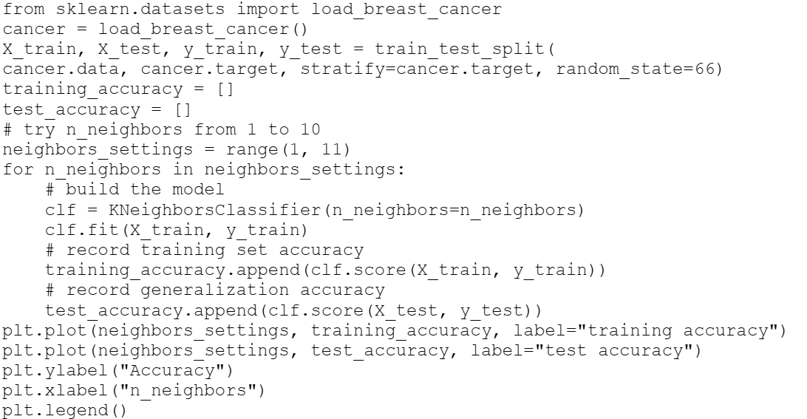
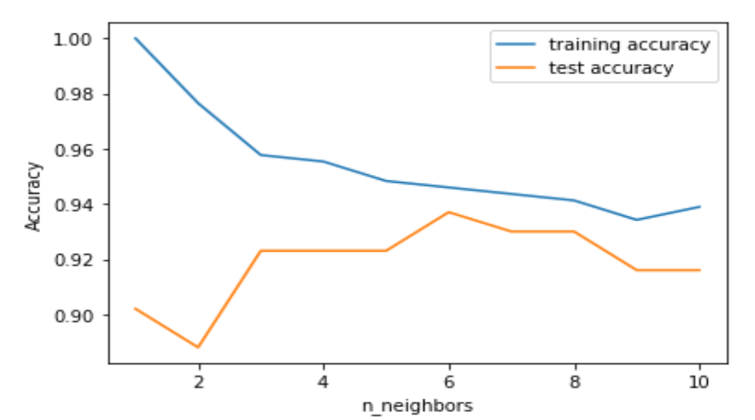
The inbuilt Breast cancer dataset consists of 569 data points (Instances) and 30 features.
When using the KNN classifier you can plot the
accuracy for different neighbors as shown.
Notice fewer neighbors have higher accuracy levels on the training data (overfitting) and low accuracy levels on the test data (no generalizability).Thus a single nearest neighbor leads to a model that is too complex.
But when more neighbors are considered, the model becomes simpler and the training accuracy drops while the test accuracy increases.
However as they increase beyond a certain point (10 in this case), the test accuracy starts to drop again.The best performance is just before that happens (around 6 neighbors).
SELECTING PARAMETERS

Slide 12
EXERCISE
Download the following dataset (from Kaggle) with 110.527 medical appointments and 14 associated variables (characteristics). Use it to create a model that can predict whether a patient will shop up for the appointment booked or not.
(www.kaggle.com/joniarroba/noshowappointments)
CLASSIFICATION EXERCISE

Slide 13
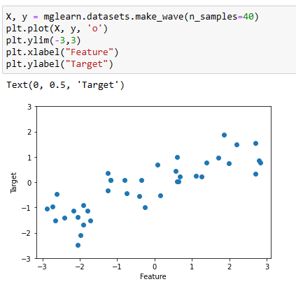
Recall this dataset? We described it as a regression problem due to the continuous class data
When we generate the dataset and visualize it.
What pattern do you notice in the data?
REGRESSION

Slide 14
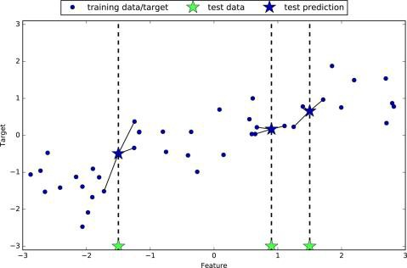
An increase in feature value leads to an increase in the class value
We can use KNN to predict data points using the same nearest neighbor concept discussed earlier.
The algorithm seeks the nearest neighbor and uses its y-axis value for prediction.
We can use more neighbors for regression. However, unlike in classification, here the prediction is the average, or mean, of the relevant neighbors.
K-NN REGRESSOR

Slide 15
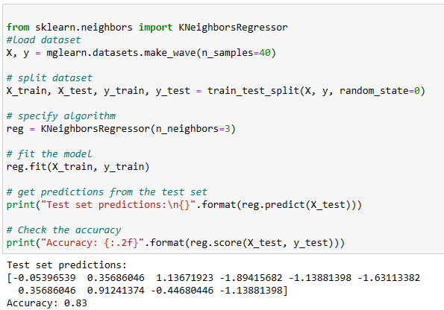
We evaluate the model using the score method. For regressors it returns the R² score which is a coefficient that determines the goodness of a prediction and ranges between between 0 and 1. A value of 1 corresponds to a perfect prediction, and a value of 0 corresponds to a constant model that just predicts the mean of the training set responses, y_train. In our case 0.83, indicates a relatively good model fit.
IMPLEMENTING KNN REGRESSOR

Slide 16
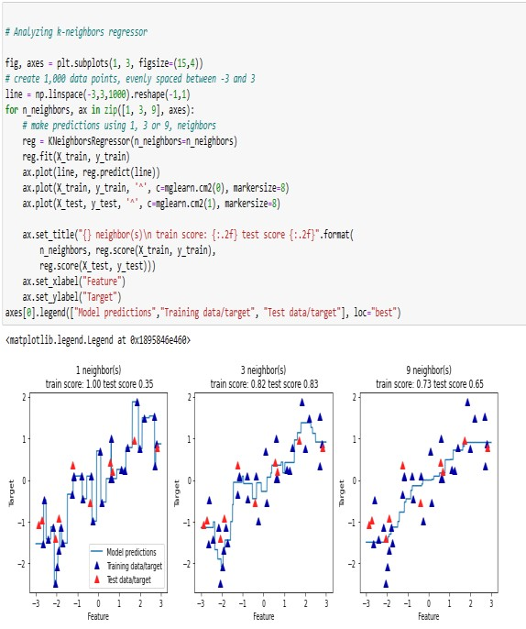
Just like KNN classifiers, the number of neighbors is very important.
This can be demonstrated by creating 1000 data points represented by a line and use a different number of neighbors to predict.
With one neighbor the predictions become the nearest neighbor training data thus each point in the training set has an obvious influence on the predictions ( a very unsteady prediction)-though more accurate.
Considering more neighbors leads to smoother predictions, but these do not fit the training data very well. Subsequently the training accuracy will be low.
Hence you need to monitor and adjust it to get a good mode. In In addition to the number of n neighbors, how you measure distance between data points is very important too.You can do this in different ways but the most common approach is the Euclidean distance which often works well -- you can explore how to edit that and test if the model improves.
NB: KNN is easy to understand, and often gives reasonable performance without a lot of adjustments. However if your training set is very large (either in number of features or in number of samples) prediction can be slow. It also performs poorly with sparse datasets (where most features are 0) hence calling for significant preprocessing. In such cases, you should explore other algorithms
ANALYZING KNN REGRESSOR

Slide 17
Download the following dataset about concrete from the UCI machine learning repository. Concrete is the most important material in civil engineering. Its compressive strength is a highly nonlinear function of age and ingredients.These ingredients include cement, blast furnace slag, fly ash, water, superplasticizer, coarse aggregate, and fine aggregate. Use it to predict Concretes compressive strength in megapascals.
(https://archive- beta.ics.uci.edu/dataset/165/concrete+compressive+strength )
REGRESSION EXERCISE

